Slide 1
(Insert School Name Here)
Notes:
Good Morning/Afternoon! Today we begin the process of planning our school’s budget for FY21. I know we are all here for the same reason and that is ensuring success for all (enter school name) students. This meeting is to provide an overview of the draft budget and for you to give feedback on the draft budget.

Slide 2
Norms
This is a meeting of the GO Team. Only members of the team may participate in the discussion. Any members of the public present are here to quietly observe.
We will follow the agenda as noticed to the public and stay on task.
We invite and welcome contributions of every member and listen to each other.
We will respect all ideas and assume good intentions.

Slide 3
GO Team Budget Development Process
YOUR SCHOOL STRATEGIC PLAN…
is your roadmap and your role. It is your direction, your priorities, your vision, your present, your future.
Step 1: Data Review
Step 2: Strategic Plan Review
Step 3: Budget Parameters
Step 4: Budget Choices
Notes:
Today I will provide an overview of the budget allocations for FY21. We will begin the work of funding the strategic priorities we agreed upon during our strategic review meeting. (IF YOU HAVE NOT DECIDED ON YOUR PRIORITIES, YOU WILL SAY – WE WILL DECIDE ON OUR PRIORITIES AND THEN DISCUSS ALLOCATING FUNDS TO ADDRESS THOSE PRIORITIES).

Slide 4
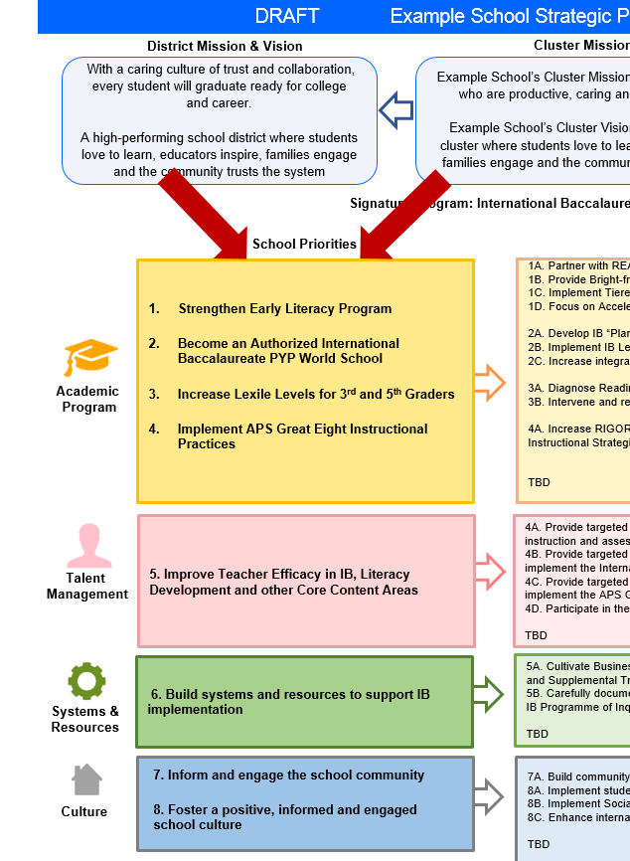
FY22 Budget Development Process
Principal’s Role
Design the budget and propose operational changes that can raise student achievement
Flesh out strategies, implement and manage them at the school level
Focus on the day-to-day operations
Serve as the expert on the school
Hire quality instructional and support personnel
The GO Team’s Role:
Focus on the big picture (positions and resources, not people)
Ensure that the budget is aligned to the school’s mission and vision and that resources are allocated to support key strategic priorities

Slide 5
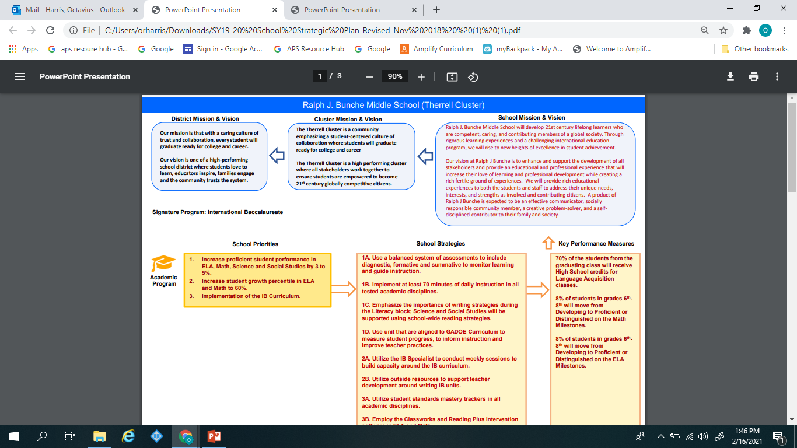
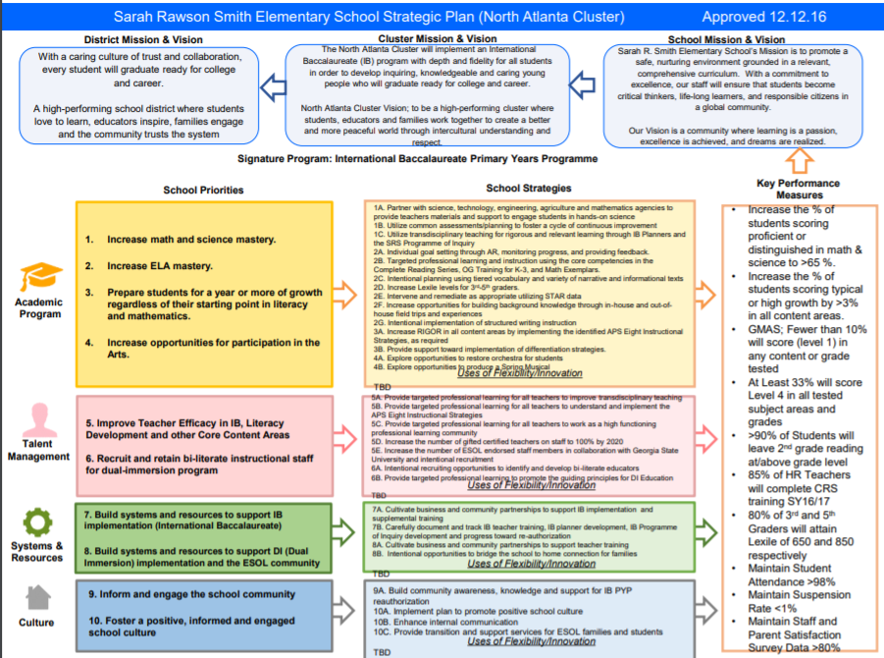
(Ralph J Bunche) Strategic Plan
(Insert Copy of Approved Strategic Plan Here)
Example
Notes:
You should have a copy of our updated strategic plan (please make copies to be distributed to team).

Slide 6
FY21 Priorities & SMART Goals
(From your Strategic Plan, insert your Top 2 Priorities & SMART Goals for FY21 here)
School Priorities
SMART Goals
Increase proficient student performance in
ELA, Math, Science and Social Studies by 3 to
5%.
8% of students in grades 6th-
8th will move from
Developing to Proficient or
Distinguished on the Math
Milestones.
Increase student growth percentile in ELA
and Math to 60
8% of students in grades 6^{th-}
8th will move from
Developing to Proficient or
Distinguished on the ELA
Milestones.
Notes:
Discuss priorities and rationale

Slide 7
Discussion of Budget Summary
(Step 4: Budget Choices)

Slide 8
Executive Summary
This budget represents an investment plan for our school’s students, employees and the community as a whole.
The budget recommendations are tied directly to the school’s strategic vision and direction.
The proposed budget for the general operations of the school are reflected at $9,234,390______
This investment plan for FY22 accommodates a student population that is projected to be 965 students, which is a decrease of 33 students from FY21.
Notes:
Here’s a few highlights for our budget this year – read executive summary

Slide 9
Executive Summary
Overall Change
The base allocation will adjust each year primarily to account for changes in average salaries, increases in compensation, and changes in benefit costs. The change in your allocation that can be attributed to changes in the base is:
 |  | Base | Students receiving weight | $ Equivalent
 | FY2021 | $4,437 | 998 | $4,428,462
 | FY2022 | $4,445 | 965 | $4,289,664
 | Change | $8 | (33) | -$138,799
Notes:
Here’s a few highlights for our budget this year – read executive summary

Slide 10
School Allocation
FY2022 TOTAL SCHOOL ALLOCATIONS
School | Bunche Middle School
Location | 0180
Level | MS
FY2022 Projected Enrollment | 965
Change in Enrollment | -33
Total Earned | $9,234,390
SSF Category | Count | Weight | Allocation
Base Per Pupil | 965 | $4,445 | $4,289,664
Grade Level
Kindergarten | 0 | 0.60 | $0
1st | 0 | 0.25 | $0
2nd | 0 | 0.25 | $0
3rd | 0 | 0.25 | $0
4th | 0 | 0.00 | $0
5th | 0 | 0.00 | $0
6th | 317 | 0.03 | $42,274
7th | 331 | 0.00 | $0
8th | 317 | 0.00 | $0
9th | 0 | 0.03 | $0
10th | 0 | 0.00 | $0
11th | 0 | 0.00 | $0
12th | 0 | 0.00 | $0
Poverty | 730 | 0.50 | $1,622,515
Concentration of Poverty |  | 0.06 | $146,899
EIP/REP | 30 | 1.05 | $140,025
Special Education | 138 | 0.03 | $18,403
Gifted | 62 | 0.60 | $165,363
Gifted Supplement | 0 | 0.60 | $0
ELL | 13 | 0.15 | $8,668
Small School Supplement | FALSE | 0.40 | $0
Incoming Performance | 380 | 0.10 | $168,919
Baseline Supplement | No |  | $0
Transition Policy Supplement | No |  | $0
Total SSF Allocation |  |  | $6,602,732
Notes:
For FY21, APS is continuing to increase equity within the District and the flexibility principals have in regards to our schools budgeted funds. The new Student Success Funding Model (SSF) allocates dollars to schools based on the number of enrolled students and receives a funding "weight" based on need. This year, student characteristics were weighted based on:
Grade Level –
K-12
Poverty – Weighted for all Direct Certification enrolled students.
Beginning Performance – Weighted Middle School and High School students entering with beginner’s performance on milestones.
ESOL – Weighted for all ESOL designated students in order to supplement due to ESOL staff being locked.
Special Education - Weighted for all Special Education students.
Gifted – Weighted and measured by number of students in the Gifted Program
Small School Supplement – Weighted for low enrollment schools
ES – 500
MS – 600
HS – 700
As you can see, our projected enrollment for FY21 is _______, we increased/decreased by __________ from last year.
We received the following weights for our student characteristics: (Below is just for the script, principals need to insert their school’s characteristics)
Grade Level
Poverty
Special Education
Gifted
Gifted Supplement
ELL
Small School Supplement

Slide 11
School Allocation
Additional Earnings
Signature |  |  | $160,500
Turnaround |  |  | $0
Title I |  |  | $652,050
Title I Holdback |  |  | -$97,808
Title I Family Engagement |  |  | $15,000
Title I School Improvement |  |  | $0
Title IV Behavior |  |  | $96,600
Summer Bridge |  |  | $23,400
Field Trip Transportation |  |  | $25,385
Dual Campus Supplement |  |  | $0
District Funded Stipends |  |  | $47,503
Reduction to School Budgets |  |  | $0
Total FTE Allotments | 21.25 |  | $1,709,027
Total Additional Earnings |  |  | $2,631,658
Total Allocation |  |  | $9,234,390
Notes:
Additionally, we received money for signature programming, turnaround, Title I and FTE Allotments.

Slide 12
Budget by Function (Required)
School | Bunche Middle School
Location | 0180
Level | MS
Principal | Mr. Octavious Harris
Projected Enrollment | 965
Account | Account Description | FTE | Budget | Per Pupil
1000 | Instruction | 77.80 | $ 6,891,093 | $ 7,141
2100 | Pupil Services | 11.25 | $ 732,802 | $ 759
2210 | Improvement of Instructional Services | 5.00 | $ 516,626 | $ 535
2213 | Instructional Staff Training | - | $ - | $ -
2220 | Educational Media Services | - | $ - | $ -
2400 | School Administration | 11.00 | $ 939,825 | $ 974
2600 | Maintenance & Operations | 2.00 | $ 134,161 | $ 139
2700 | Transportation | - | $ - | $ -
Total |  | 107.05 | $ 9,214,508 | $ 9,549
Notes:
I am passing out the definitions for these funding categories. You will see what makes up each category. Although the total amount will not change, allocation per function may depending on our conversations and school needs.

Slide 13
Budget by Function (Required)
Example
Notes:
Explain the pie chart and allocations

Slide 14
What’s Next?
January:
Principals Receive Budget (Jan. 21st-31st)
February:
One-on-one Associate Superintendent discussions
Cluster Planning Session (positions sharing, cluster alignment, etc.)
Program Manager discussions and approvals
HR Staffing Conferences (February 24th - March 2nd)
• March:
Final GO Team Approval (March 3rd - March 13th)
Notes:
In February, we will meet again to discuss how the school’s budget has been allocated to support the programmatic needs and FY21 key strategic priorities.
If think we need to continue our budget conversations, we will schedule additional meetings. My goal is to make sure your voices are reflected in our school’s budget.
I will also be meeting with my Associate Superintendent, program managers and other key leaders to go over our budget and to make sure the school is meeting the standards of service and appropriately staffing.
During the week of Feb. 24th -March 2nd , HR Staffing Conferences will be held. At this meeting, I will present my plan for staff utilization, resource distribution and plan for staffing implications.
We will need to approve the budget at the ________ meeting.

Slide 15
Questions?
Thank you for your time and attention.
Notes:
IF YOU FEEL YOUR TEAM IS READY TO APPROVE THE DRAFT BUDGET, PLEASE DO SO. PLEASE REMIND THEM THAT YOU MAY NEED TO MEET WITH THEM AGAIN, IF THERE ARE CHANGES FROM YOUR MEETINGS WITH DISTRICT LEADERSHIP. LET THEM KNOW YOU WILL KEEP THEM INFORMED!!

Slide 16
Slides to Complete After Initial Meeting and Before You Meet with Associate Supt. And Program Managers

Slide 17
Focus Area Descriptors
Strategic Plan Categories | District Descriptions of Categories
Academic Program | Our students will be well-rounded individuals who possess the necessary academic skills and knowledge and are excited about learning.
Talent Management | We will retain an energized and inspired team of employees who are capable of advancing ever-increasing levels of achievement for students of all backgrounds.
Systems & Resources | We will improve efficiency (productivity, cost, etc.) while also making decisions (including resource allocations) that are grounded in a strategic academic direction and data.
Culture | We will build trust with the community, and we will have engaged stakeholders (employees, students, parents, community members, partners, etc.) who are invested in the mission and vision and who support the creation of student-centered learning communities.
Notes:
I have printed the terms on the next two slides for your convenience. I want to just go over them so we will all be on the same page as we move forward in this process. If you have any questions, please don’t hesitate to ask.

Slide 18
Description of Strategy Categories
Budget Parameters – FY21 funding priorities from the school’s 3-5 year strategic plan, ranked by the order of importance
Strategies – Lays out specific objectives for schools improvement
Request – “The Ask”. What needs to be funded in order to support the strategy?

Slide 19
FY22 Budget Parameters
FY21 School Priorities | Rationale
Increase proficient student performance in ELA, Math, Science and Social Studies by 3 to 5%. | The need to continue to close the achievement gap of minorities remains the focus of our instructional program
Increase student growth percentile in ELA and Math to 60% | This needs is increase due to academic slide caused by the pandemic
Implement Advancement Via Individual Determination (AVID) Program to individualized course determination based on student readiness.? | We are continue to increase the effectiveness of our AVID Program. Students in the program have demonstrated success in grade level classes and advance classes
Retain effective teaching staff and recruit High Quality staff. | Incentive new teacher hire to recruit the best and providing leadership development opportunities for veteran teachers
Notes:
Review the priorities that the GO Team has developed and the rationale for these priorities

